Slide 1
Basic data structure and Graph
Array
Stack
Queue
Deque
STL
Graph
Tree

Slide 2
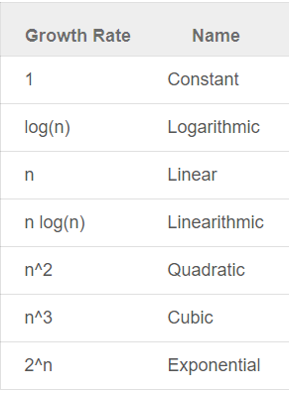
Big O notation
Big O is defined as the asymptotic upper limit of a function. In plain English, it means that is a function that cover the maximum values a function could take. This notation help us to predict performance and compare algorithms

Slide 3
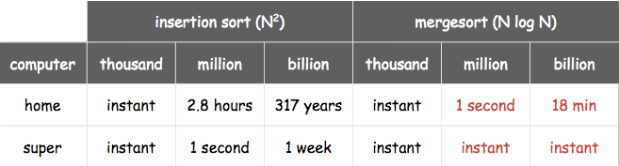
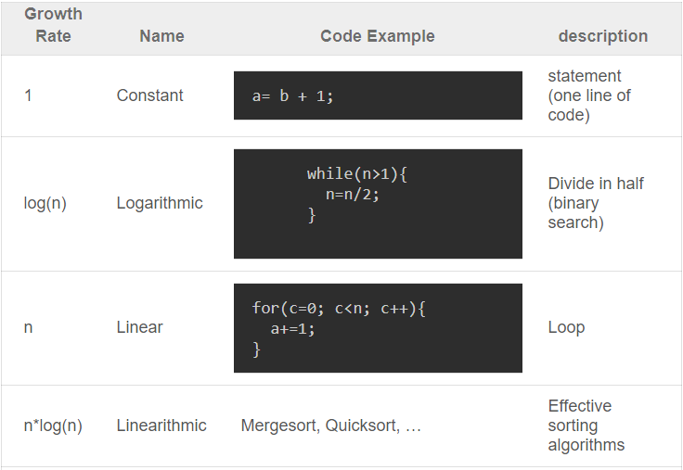
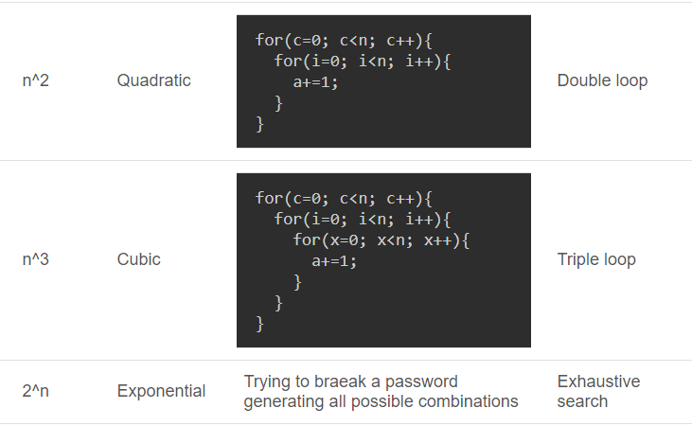

Slide 4
Array
Most basic data structure
Two type static and dynamically allocated array
Static | Dynamic
Note: Should declare {0} so that all the element of the array is 0 With array of more than 500 000 elements, declare outside main function O(1) access, alter. Use memset(a,0,sizeof(a)) to reset the array to 0. Note this should only be 0 because it deals with bits not value | Pointer ( but too hard ) C++ Vector is the best option Use the method resize() Note pop_back() + push_back() is O(1) all other method O(n) because vector is a sequence container

Slide 5



Vector

Slide 6
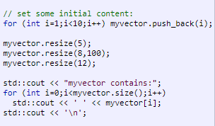
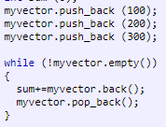
Vector

Slide 7
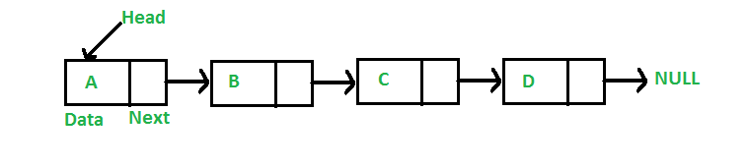

Linked list
Most used data structure other than array.
Link list is a self-reference data structure.
Just need to understand it, no need to code it.
The data structure that is used to implement all others

Slide 8
Linked list
Unlike arrays, linked list elements are not stored at contiguous location; the elements are linked using pointers.
O(1) insertion, deletion
Advantages over arrays 1) Dynamic size 2) Ease of insertion/deletion
Drawbacks: 1) Random access is not allowed. We have to access elements sequentially starting from the first node. So we cannot do binary search with linked lists. 2) Extra memory space for a pointer is required with each element of the list.
In C++, use list. For usage go to cplusplus.com
http://codeforces.com/contest/264/problem/A

Slide 10
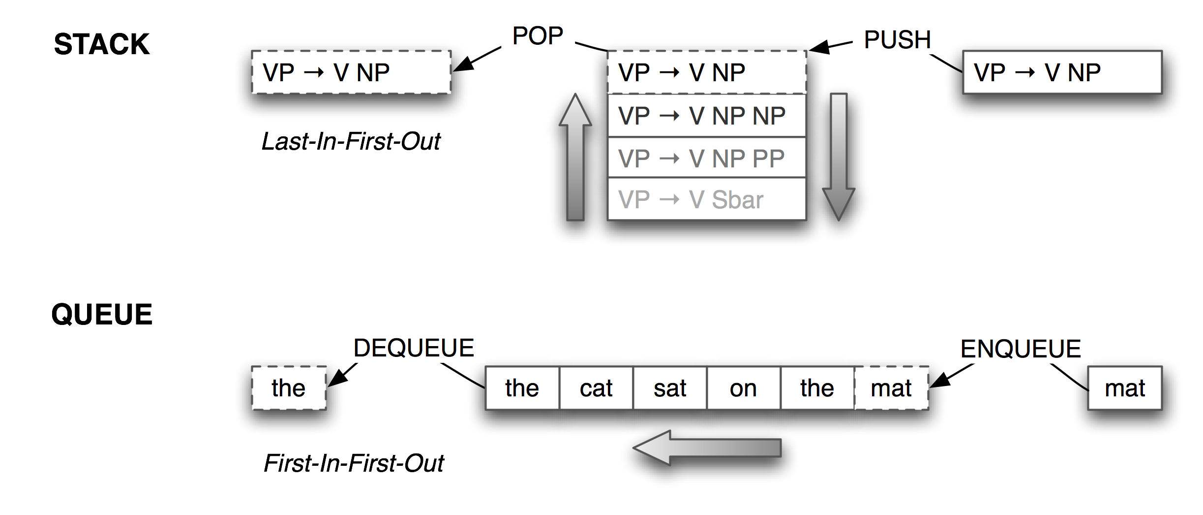
Stack, Queue
Stack: First In Last Out (FILO)
Queue: First In First Out (FIFO)

Slide 11
Stack, Queue
Available in C++
For reference go to cplusplus.com
Example problem: Given an array a. Find the first element to the left that is smaller than a[i] ( 1 <= i <= n)
With this problem we can do a O(n^2) brute force algorithm
With stack we can do in O(n)

Slide 13
Stack, Queue
http://codeforces.com/problemset/problem/26/B
http://codeforces.com/contest/81/problem/A
http://acmicpc-vietnam.github.io/2016/regional/problems.pdf ( Solve A using queue)
https://www.hackerearth.com/practice/data-structures/arrays/1-d/practice-problems/algorithm/the-amazing-race-1/

Slide 18
Deque
Double ended queue
Can pop in the back and in the front in O(1)
deque (usually pronounced like "deck") is an irregular acronym of double-ended queue. Double-ended queues are sequence containers with dynamic sizes that can be expanded or contracted on both ends (either its front or its back) => Can be accessed through [] operator like vector. Has all the function vector has. Can be used with binary search
http://www.cplusplus.com/reference/deque/deque/
Both vectors and deques provide a very similar interface and can be used for similar purposes, but internally both work in quite different ways: While vectors use a single array that needs to be occasionally reallocated for growth, the elements of a deque can be scattered in different chunks of storage
Therefore the indexing operator[]() could take more time because you need to determine the certain chunk of memory at first and then the position of an element in this chunk

Slide 19
STL
The Standard Template Library (STL) is a software library for the C++ programming language that influenced many parts of the C++ Standard Library. It provides three components called algorithms, containers, and iterators.
Containers are used to store a collection of objects
Most used containers:
vector
pair
list
priority_queue
set
map
multimap/set
bitset
stack/queue

Slide 20

STL
Iterators: An iterator is any object that, pointing to some element in a range of elements (such as an array or a container), has the ability to iterate through the elements of that range using a set of operators (with at least the increment (++) and dereference (*) operators).
Three main type of iterator that you will work with: bidirectional iterators (that are like forward iterators, but can also move backwards) and random access iterators (that can move freely any number of steps in one operation), forward iterators (that can be read, written to, and move forward) .
Bidirectional: set, map,…
Random access: vector
Forward: multimap/set

Slide 21
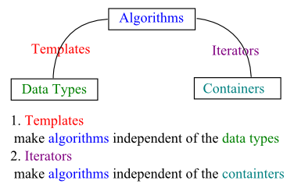
STL
Algorithm: A large number of algorithms to perform activities such as searching and sorting are provided in the STL, each implemented to require a certain level of iterator (and therefore will work on any container that provides an interface by iterators).
Note algorithm in stl usually use container.begin(),container.end() as the two parameters :
v.end() pointer points to the end of the vector, no element.
The parameter passed in is taken as [ ) not [ ]

Slide 22
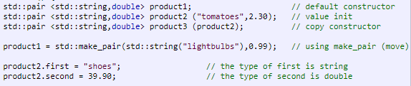
Pair

Slide 23
Set
Sets are containers that store unique elements following a specific order.
In a set, the value of an element also identifies it (the value is itself the key, of type T), and each value must be unique. The value of the elements in a set cannot be modified once in the container (the elements are always const), but they can be inserted or removed from the container.
Red black tree – self balance binary tree
Time complexity for insertion, deletion, finding,.. is O(log(n))

Slide 24

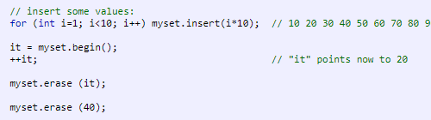
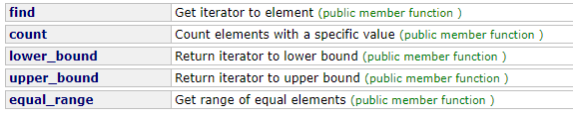
Set

Slide 25

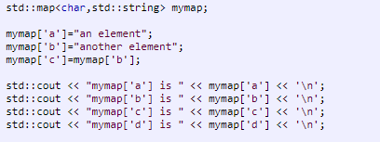
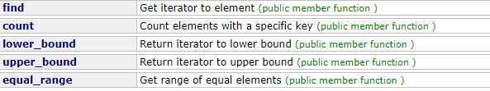
Map
Red black tree same as set
Store two value key and value. Key are used to be insert and compare in the red black tree. Value are used for storing

Slide 26
STL
For more reference read:
http://www.mediafire.com/file/5o1gllos4gjkz3k/STL.pdf
https://hochiminh17.kattis.com/problems/icpcawards (solve with map)
https://www.hackerearth.com/practice/algorithms/searching/binary-search/practice-problems/algorithm/bishu-and-soldiers/ (solve with sort and binary search)

Slide 29
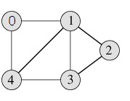
Graph and tree
Graph is a data structure that consists of following two components:
1. A finite set of vertices also called as nodes.
2. A finite set of ordered pair of the form (u, v) called as edge. The pair is ordered because (u, v) is not same as (v, u) in case of directed graph. The pair of form (u, v) indicates that there is an edge from vertex u to vertex v. The edges may contain weight/value/cost.
Following is an example undirected graph with 5 vertices.

Slide 30
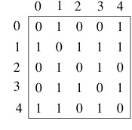
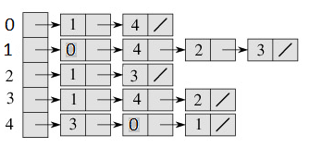
Graph and tree
Following two are the most commonly used representations of graph. 1. Adjacency Matrix: slot adj[i][j] = 1 indicates that there is an edge from vertex i to vertex j
2. Adjacency List:An array of linked lists is used. Size of the array is equal to number of vertices. Let the array be array[]. An entry array[i] represents the linked list of vertices adjacent to the ith vertex.

Slide 31
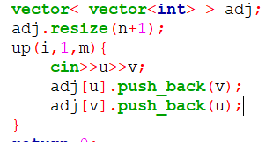
Graph and tree
Cyclic: A graph is cyclic if the graph comprises a path that starts from a vertex and ends at the same vertex. That path is called a cycle. An acyclic graph is a graph that has no cycle.

Slide 32
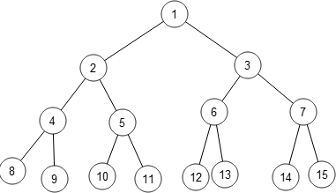
Graph and tree
Tree is a connected graph with no loops. => n vertices and n-1 edges
Root node: if not stated then can choose any

Slide 33
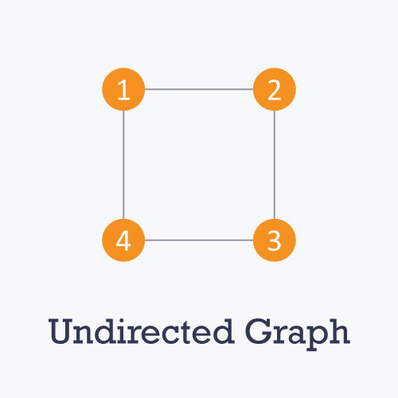
Graph and tree
Undirected

Slide 34
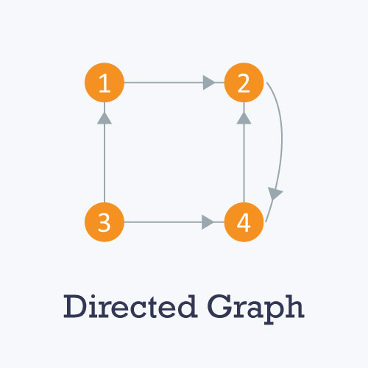
Graph and tree
Weighted

Slide 35
Graph and tree
https://www.hackerearth.com/practice/algorithms/graphs/graph-representation/practice-problems/algorithm/monk-at-the-graph-factory/
https://www.hackerearth.com/practice/algorithms/graphs/graph-representation/practice-problems/algorithm/monk-in-the-real-estate/

Slide 36
There is a bug in my code. Find it please ?

